Slide 1
Renting_data_analysis
File created on: 4/26/2023 3:34:04 PM

Slide 2
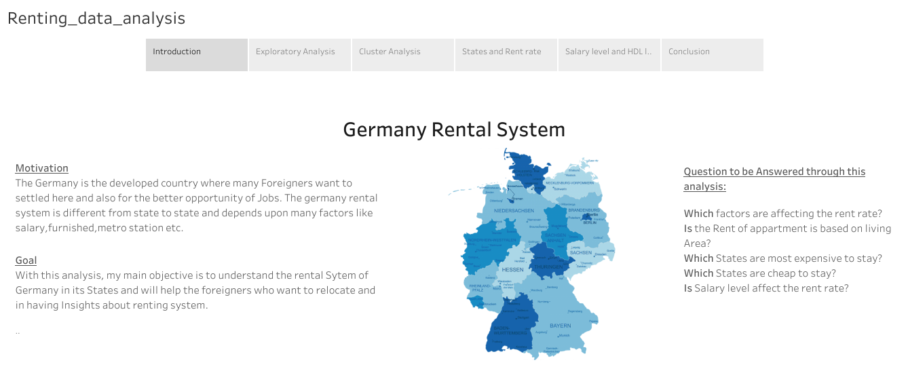

Slide 3
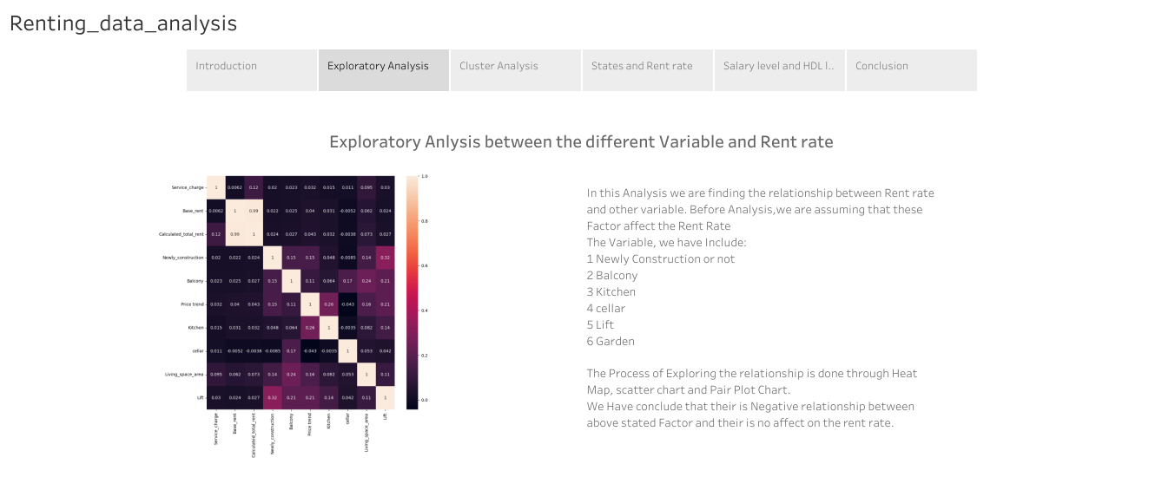

Slide 4
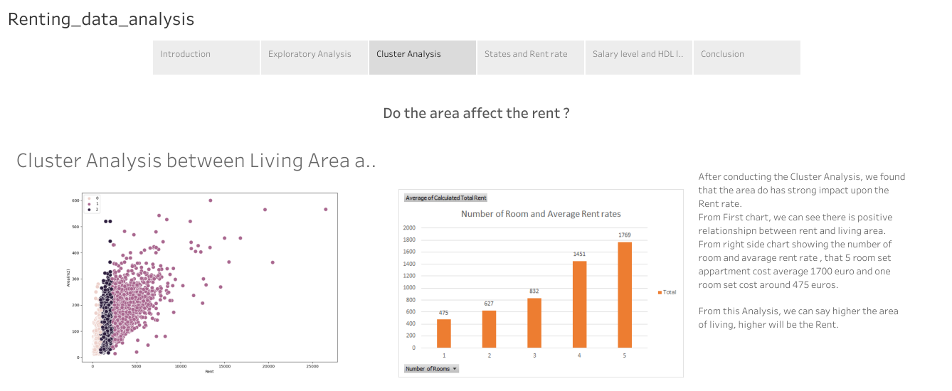

Slide 5
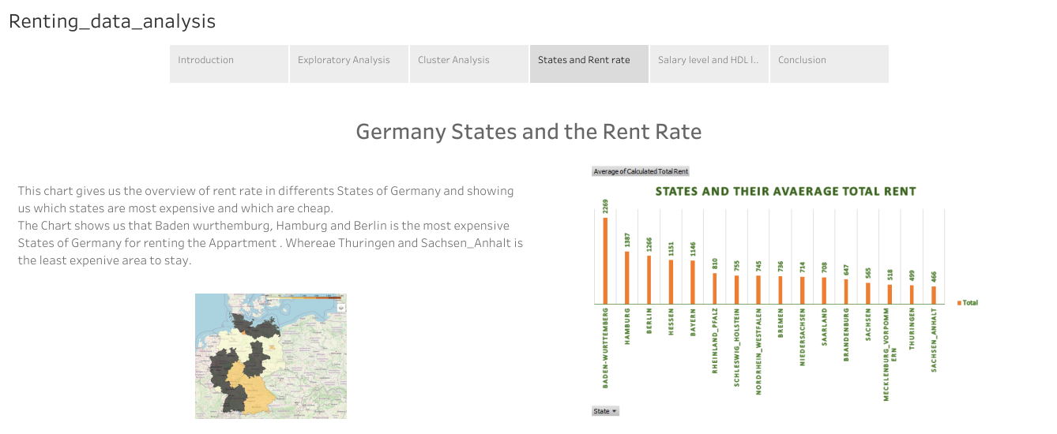

Slide 6
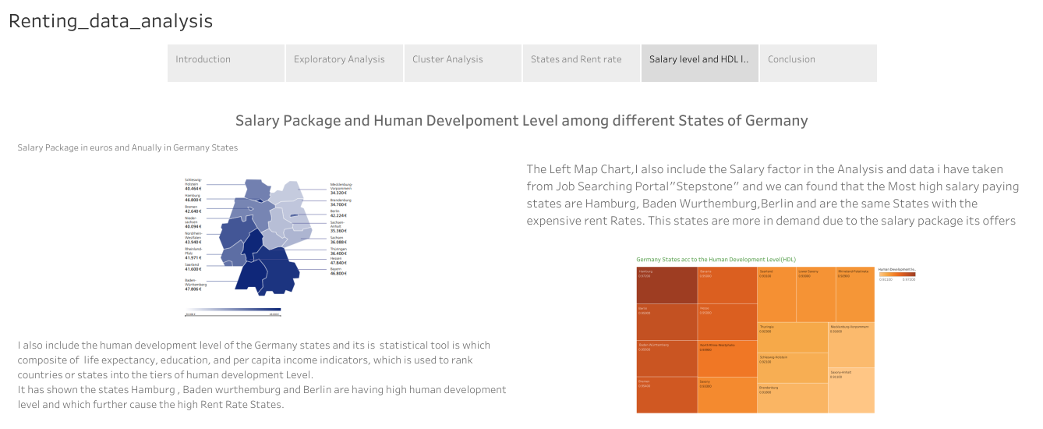

Slide 7
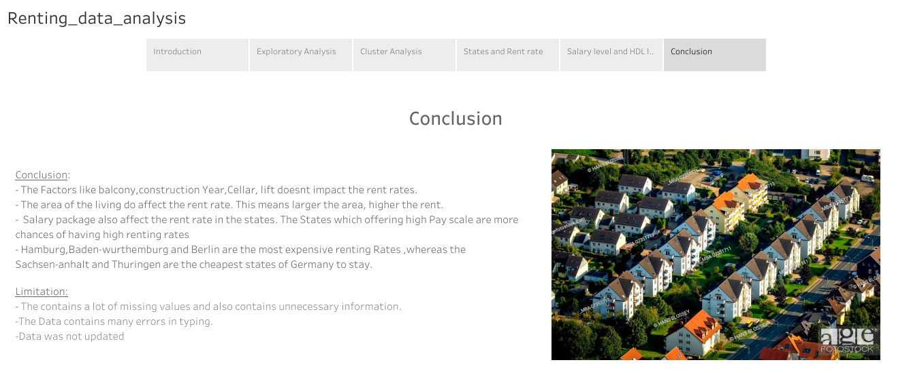

Slide 8
https://public.tableau.com/shared/J6H49WWHW?:display_count=n&:origin=viz_share_link

